Slide 1
Data analysis on Crime.
By
Fakhruddin Tahery
B M Tanvi Raj
Arshi Khan
b.Nishanth varma

Slide 2
Goals of the project
Recognize the type of crimes that occur at different places all around Chicago [USA].
Predict and provide preventive measures for the citizens in order to avoid the possible crime situations.
Portray a list to the society the type of crimes possible at particular places.
Provide type, rate and count of any crime in chronological order till date.

Slide 3
Description about SRS
Functional Requirements :
Predict location based and crime type based rate and count.
Generate heat maps where the crime is mostly concentrated.
Provide solutions to crime problems.
To predict which crimes are going to escalate.

Slide 4
Description about SRS
Software system attributes
Reliability
Availability
Security
Portability
Performance

Slide 5
Description about SRS
Performance Requirements
Application won’t fail without manual intervention.
Will be built in common technology, platform in order to avoid compatibility issues.
Will ensure easy scalability and extensibility.

Slide 6
Description about SRS
Design constraints :
Understandability
Speed
Costs
Data Relevance
Avoid Undue Delay

Slide 7
Description about the Datasets
Retrieved the data from “data.cityofchicago.org”.
Columns are present describing the following areas of interest :
Year
Primary type
Location
Longitude
Latitude
Arrest [ Yes or No ]

Slide 8
Implementation Details
Visualization of data is done using SAP Lumira.
Predict data using Python language by performing sufficient coding.
Polynomial Regression is the method used for the prediction.

Slide 9
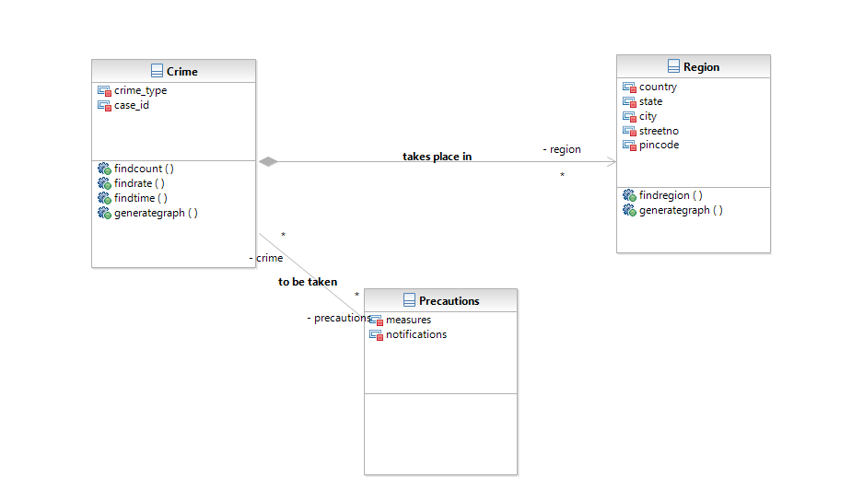
Class Diagram

Slide 10
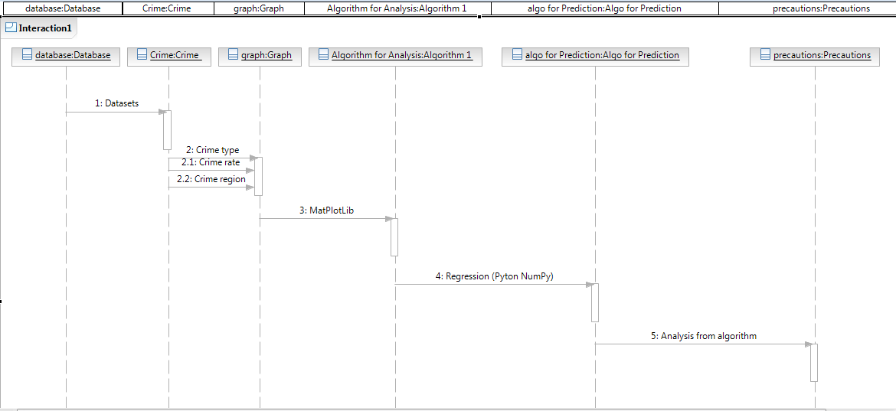
Sequence Diagram

Slide 11
Results
Successfully completed the task of predicting the type of crime that has a possibility to occur at a particular place.
Providing preventive measures for the society about the crimes that can happen at a particular place.
Presenting the rate ,count and type of crimes to the public.

Slide 12
Bibliography
Downloaded the SAP Lumira software from https://www.sapstore.com/solutions/99008/SAP-Lumira%2C-standard-edition?url_id=text-us-sapcom-lumira-1dx
Acquired the datasets from data.cityofchicago.org
Polynomial Regression formulas from the internet.

Slide 13
Thank you

